Slide 1




The imprint of climate in phylogenetic trees: a global analysis on the diversification of Tetrapod families
Théo Pannetier
Study carried out in the Phylogénie et Évolution Moléculaires at the ISEM,
under the supervision of Fabien Condamine

Slide 2


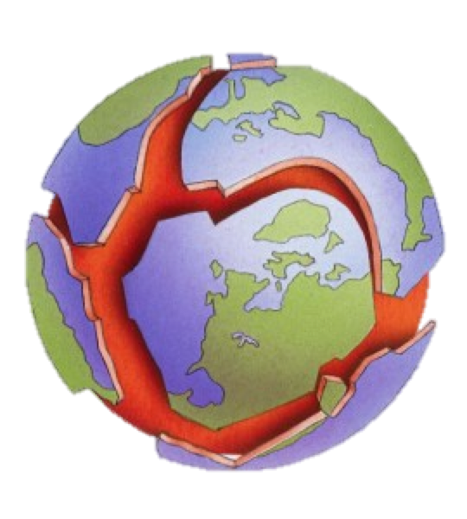
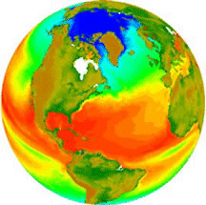
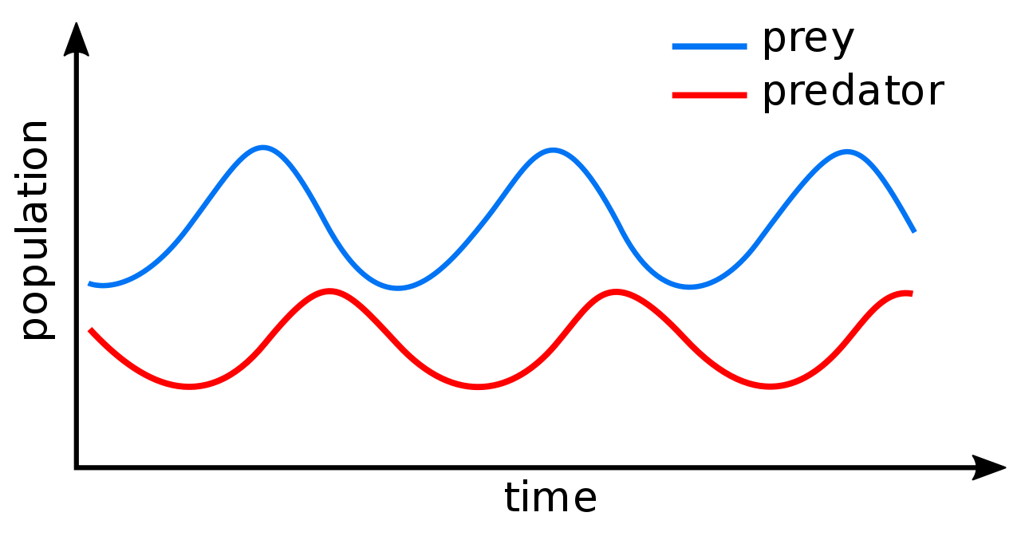
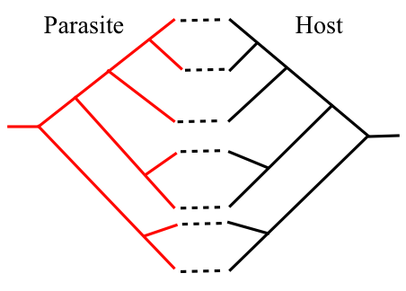
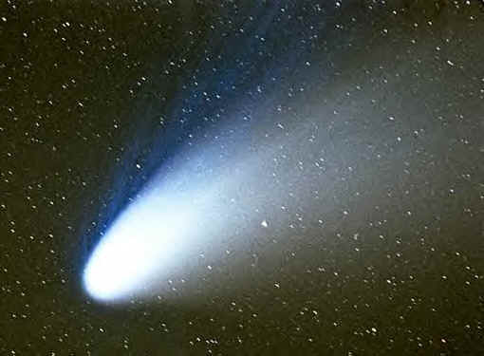
Introduction
1. Drivers of diversity in macroevolution
Drivers of diversity :
Two concurrent hypothesis
Benton 2009 – Science
Red Queen
Diversification process driven by biotic factors
→ Effects through biotic interactions
Court Jester
Diversification process driven by abiotic factors
→ Effects through the environment

Slide 3
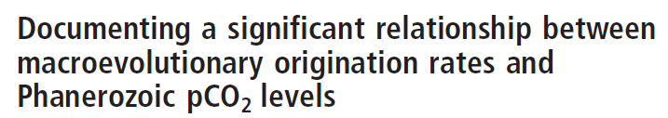
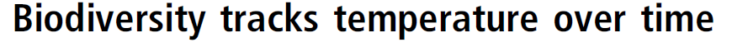
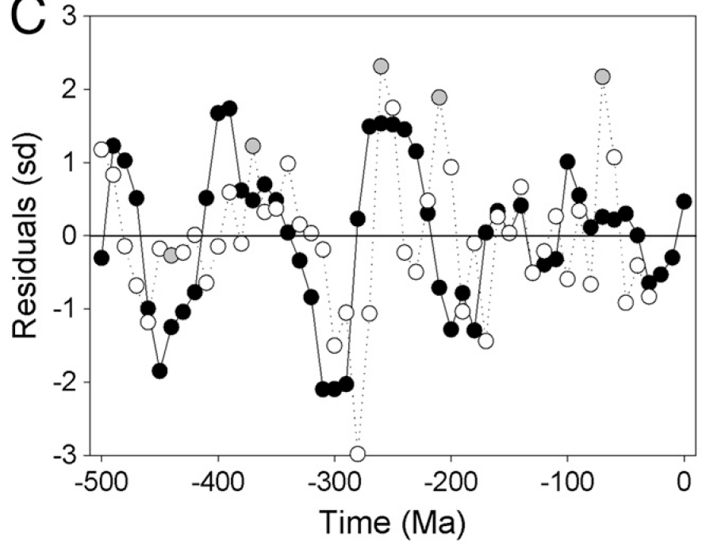
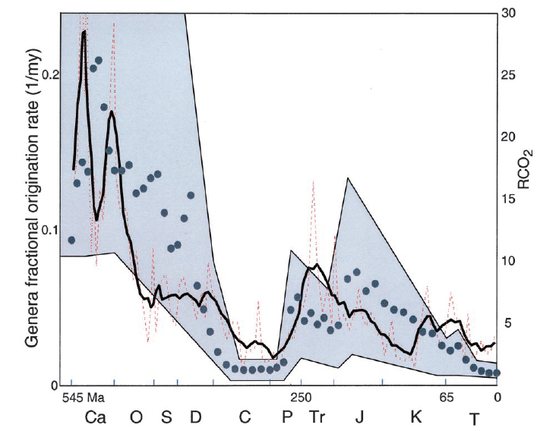
Introduction
2. The imprint of climate in the fossil record
Temperature → Climate
CO2 → Climate
Temperature
CO2
Speciation
Extinction
Speciation
Mayhew et al. 2012 – PNAS
Cornette et al. 2002 – PNAS

Slide 4
Introduction
2. The imprint of climate in the fossil record
Temperature → Climate
CO2 → Climate
Limits to the fossil-based approach
Well-documented groups only (Tertiary Mammals, Foraminifera)
Heterogeneous record, observation & conservation bias
Température
CO2
Spéciation
Extinction
Spéciation
Mayhew et al. 2012 – PNAS
Cornette et al. 2002 – PNAS

Slide 5
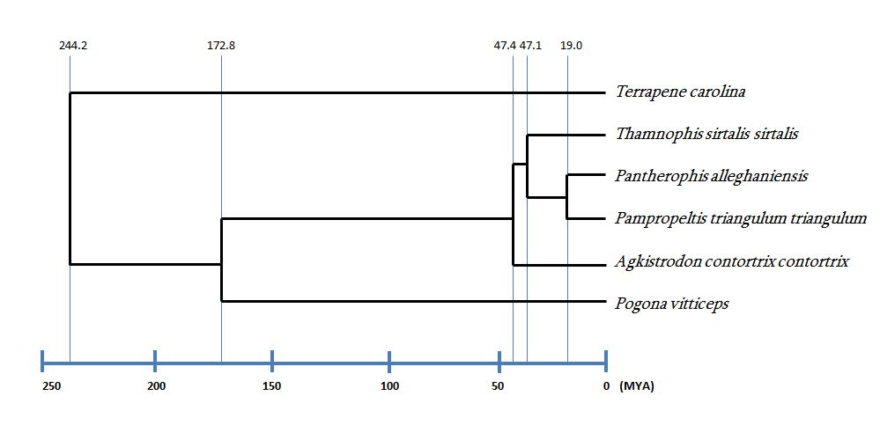
Introduction
3. A phylogeny-based approach of diversification
Another source of information available : molecular phylogenies
Diversification = Speciation (λ) – Extinction (µ)
Diversification rate can be inferred from branch lengths
Nee et al. 1994 – PTRSB
Stadler 2013 – J. Evol. Biol.
Morlon 2014 – Ecol. Lett.

Slide 6
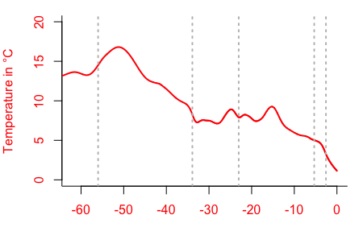
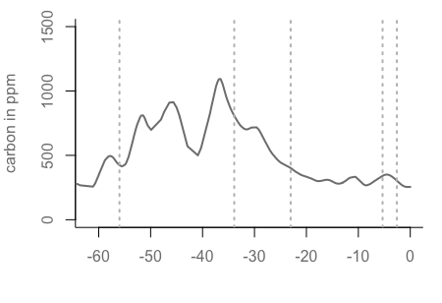
Introduction
3. A phylogeny-based approach of diversification
?
Temperature
Diversification
λ
CO₂
Diversification
λ

Slide 7
Introduction
3. A phylogeny-based approach of diversification
?
Temperature
Diversification
λ
µ = 0
CO₂
Diversification
λ
µ = 0

Slide 8
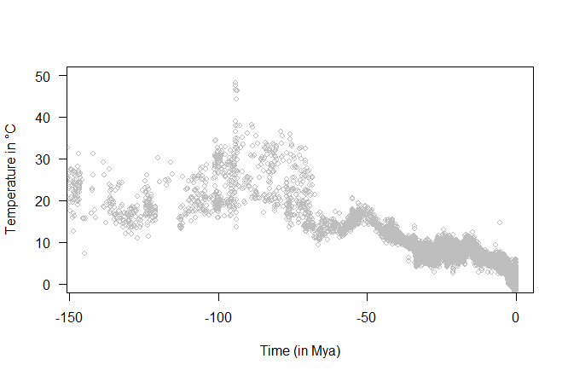
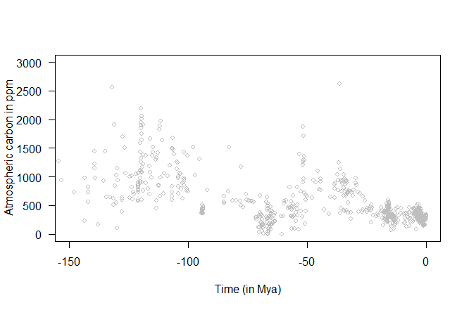
Data
Climatic data obtained from two datasets covering the whole 500 Mya
Global temperature
Atmospheric CO₂
°C
ppm
Time (Mya)
Zachos et al. 2008 – Nature
Prokoph et al. 2008 – Earth-Sci. Rev.
Cramer et al. 2011 – J. Geophys. Res.
Foster et al. 2017 – Nat. Comm.

Slide 9
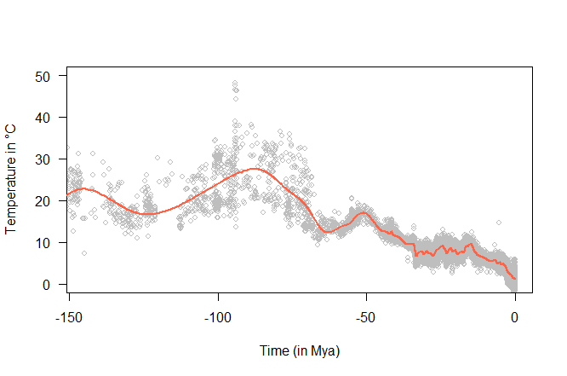
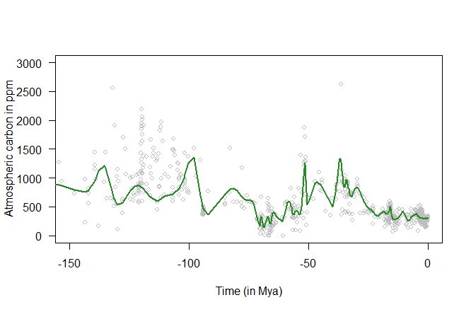
Data
Climatic data obtained from two datasets covering the whole 500 Mya
Global temperature
Atmospheric CO₂
°C
ppm
Time (Mya)
Discrete data points
→ Continuous curve
Zachos et al. 2008 – Nature
Prokoph et al. 2008 – Earth-Sci. Rev.
Cramer et al. 2011 – J. Geophys. Res.
Foster et al. 2017 – Nat. Comm.

Slide 10
Data
Dated phylogenies for the six main clades of Tetrapods
Clade | Number of species | Taxon sampling | Authors | Number of families
Crocodylia | 25 | 100% | Oaks (2011) | 1
Aves | 11 000 | 99% | Jetz et al. (2012) | 129
Testudines | 330 | 91% | Rodrigues & Diniz-Filho (2016) | 7
Mammalia | 5 500 | 99% | Bininda-Emonds et al. (2007) | 66
Squamates | 10 500 | 41% | Zheng & Wiens (2016) | 14
Amphibia | 7 700 | 37% | Pyron (2014) | 15

Slide 11
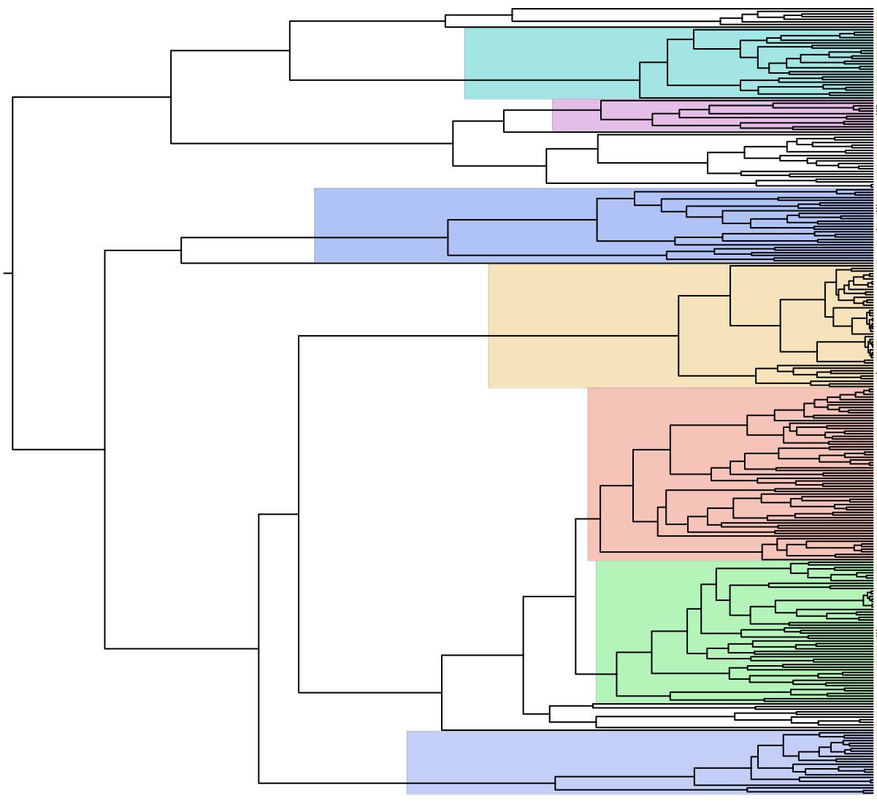
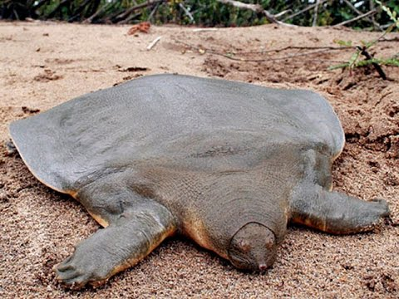
Data
Exemple with Testudine phylogeny (turtles & tortoises)
Criterions for inclusion in the sample:
1) At least 10 spp
2) At least 60 % of the taxa
7 families
Sampling
Pelomedusidae
Chelidae
Trionychidae
Emydidae
Geoemydidae
Testudinidae
Kinosternidae
100%
60%
60%
92%
94%
91%
96%
Testudines
Trionychidae

Slide 12
Data
Exemple avec la phylogénie des Testudines (tortues)
Extraction des familles avec :
1) Au moins 10 espèces
2) Au moins 60% des taxons échantillonnés
7 familles
Echantillonnage
Pelomedusidae
Chelidae
Trionychidae
Emydidae
Geoemydidae
Testudinidae
Kinosternidae
100%
60%
60%
92%
94%
91%
96%
Final sample size :
232 phylogenies
~ 17 000 spp. (> 50% total specific richness)
Testudines
Trionychidae

Slide 13
Models
Four speciation models were tested on each phylogeny
Constant model
λ(t) = λ
Speciation rate constant & independent
Time-dependent model
λ(t) = λ x e^{αt}
Speciation rate increases/decreases through time
Temperature-dependent model
λ(t) = λ x e^{α T°(t)}
Speciation rate is function of temperature
CO₂ -dependent model
Speciation rate is function of a CO2
λ(t) = λ x e^{α CO2(t)}

Slide 14
models
Four speciation models were tested on each phylogeny
Constant model
λ(t) = λ
Two parameters :
λ « background » speciation rate
α strength and sense of the dependency
Time-dependent model
λ(t) = λ x e^{αt}
Temperature-dependent model
λ(t) = λ x e^{α T°(t)}
Variable
CO₂ -dependent model
α > 0
Spéciation
λ
λ(t) = λ x e^{α CO2(t)}
α < 0
Time

Slide 15
models
Quatre types de modèles de spéciation testés sur chaque phylogénie
Modèle constant
λ(t) = λ
Deux paramètres:
λ correspond à un taux de spéciation sous-jacent
α spécifie l’intensité et surtout le signe de dépendance à la variable testée
Modèle temps-dépendant
λ(t) = λ x e^{αt}
Parameter optimisation → Maximum likelihood
Model selection → AIC
Modèle température-dépendant
Température λ(t) = λ x e^{α T°(t)}
Variable
Modèle CO₂ -dépendant
α > 0
Spéciation
CO₂ λ(t) = λ x e^{α CO2(t)}
α < 0
Temps

Slide 16
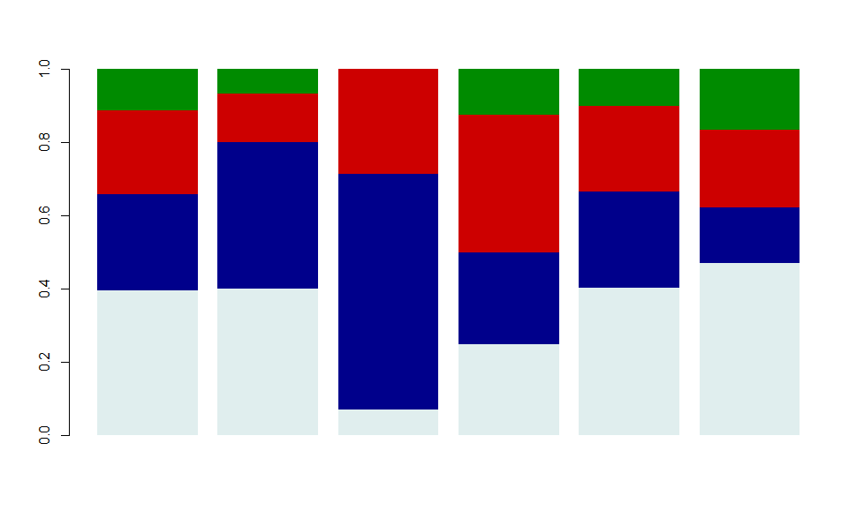
Results
Results of model selection
Overall results for the 232 families
N = 232
CO₂-dependent model
26 families – 11%
Temperature-dependent model
53 families – 23%
Time-dependent model
62 families – 27%
Constant model
91 families – 39%

Slide 17


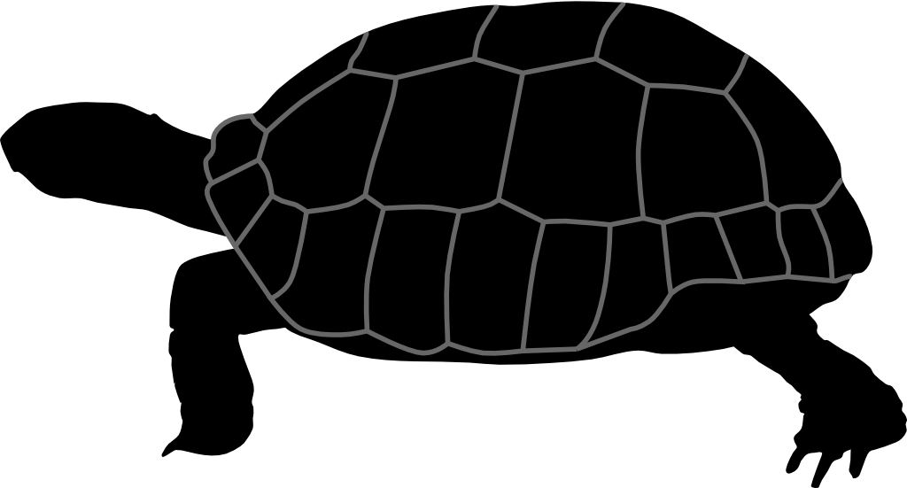



Results
Results of model selection
Overall results for the 232 families
CO₂-dependent
T°-dependent
Time-dependent
Constant
N = 232
N = 15
N = 14
N = 7
N = 129
N = 66
N = 1

Slide 18
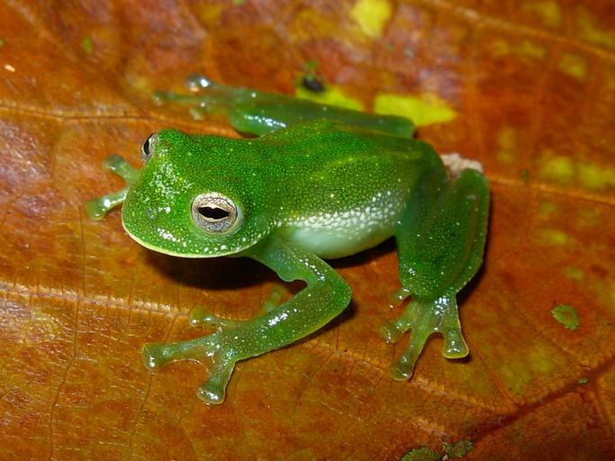
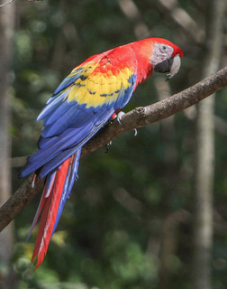
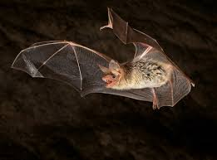
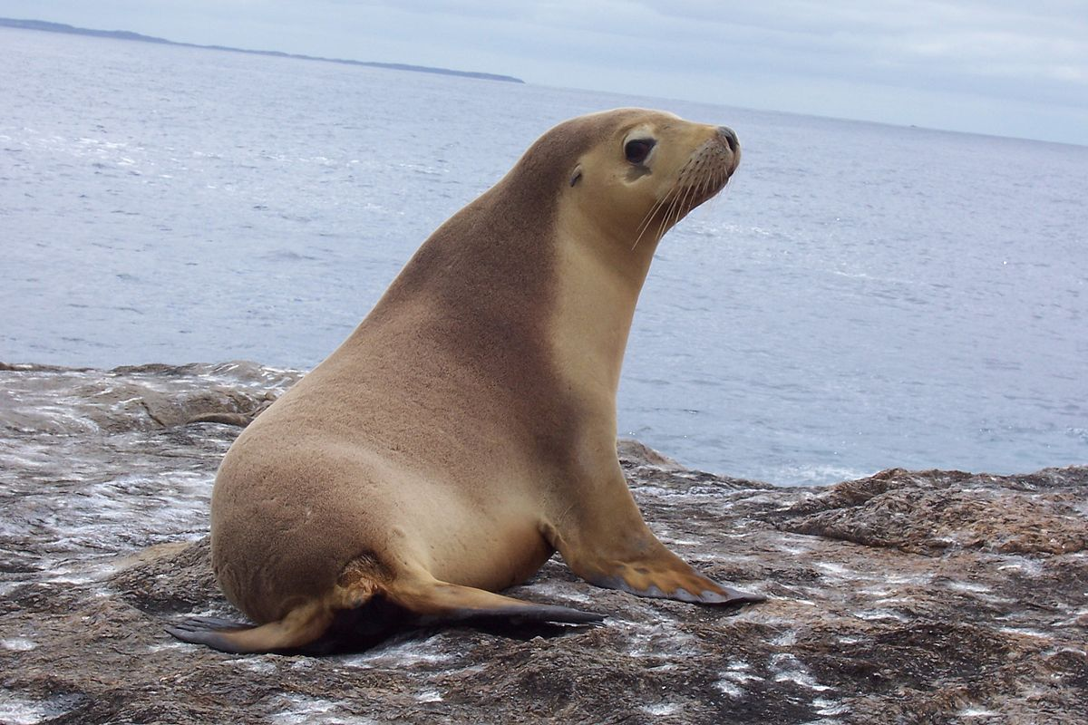
Discussion
34% of families: speciation rate variations best explained by climatic variations (CO₂ & temperature)
1 - Signal of climate : rule or exception ?
Signal found in the 6 main clades of living tetrapods

Slide 19

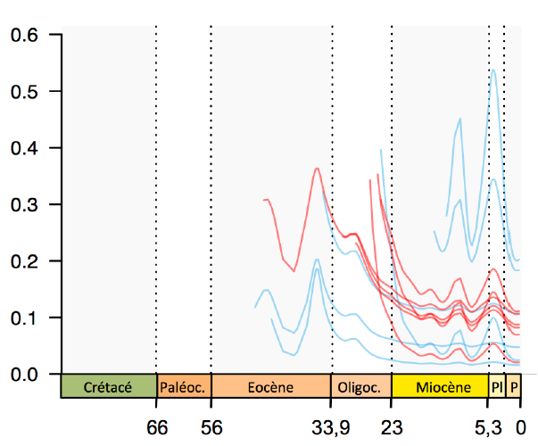
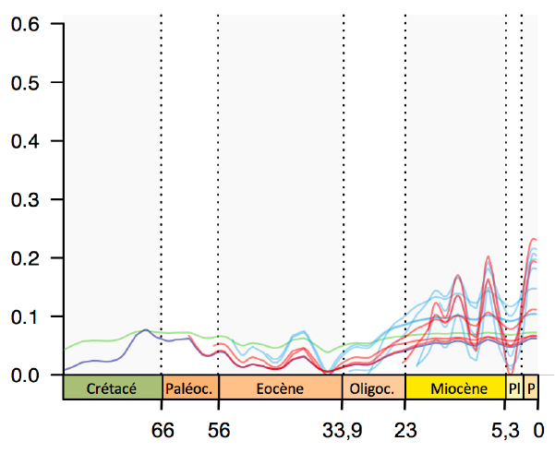

Results
CO2-dependent speciation
Positive correlation α > 0
Negative correlation α < 0
48 %
52 %
Spéciation (λ)
Spéciation (λ)
Time (Mya)
Time (Mya)
13
0
2
11
1

Slide 20
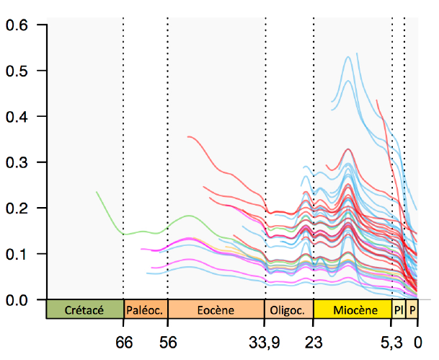
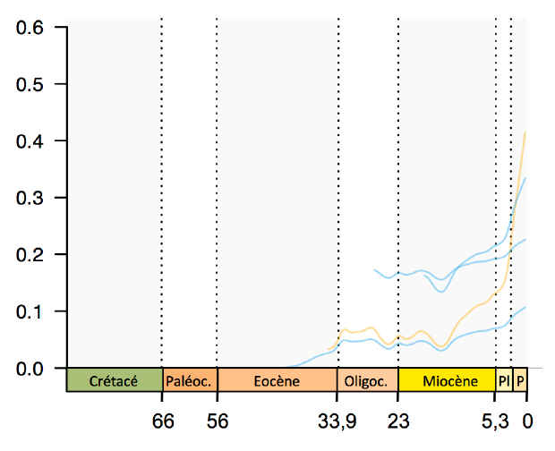
Results
Temperature-dependent speciation
Positive correlation α > 0
Negative correlation α < 0
92 %
8 %
Spéciation (λ)
Spéciation (λ)
Time (Mya)
Time (Mya)
30
4
2
14
3

Slide 21
Discussion
2 - Do warm climates promote or inhibit speciation ?
Positive correlation
Negative correlation
92 %
8 %
Speciation rate increases as temperature increases

Slide 22
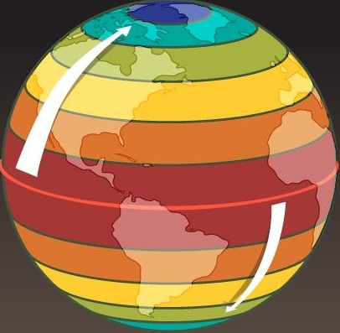
Discussion
2 - Do warm climates promote or inhibit speciation ?
Positive correlation
Negative correlation
92 %
8 %
Speciation rate increases as temperature increases
Latitudinal gradient of diversity

Slide 23
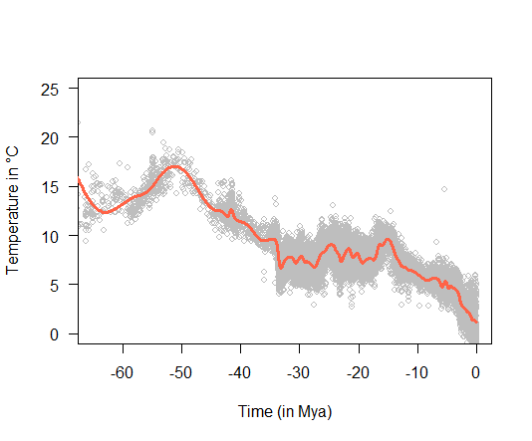
Discussion
Speciation rate increases as temperature increases
Global cooling over the Cenozoic
Speciation slowdown
T°
λ(t)

Slide 24
Discussion
Phillimore & Price 2008 – PLoS Biol.
Glor 2010 – AREES
Rabosky 2013 – AREES
Moen & Morlon 2014 – TREE
Speciation slowdown often inferred from phylogenies
Some hypotheses
Diversity-dependent speciation
Etienne et al. 2012 Proc. R. Soc. B
Protracted speciation
Rosindell et al. 2010 – Ecol. Lett.
As niches fill over time there are less opportunities for speciation
Underestimated speciation at present due to ongoing speciation events

Slide 25
Discussion
Phillimore & Price 2008 – PLoS Biol.
Glor 2010 – AREES
Rabosky 2013 – AREES
Moen & Morlon 2014 – TREE
Speciation slowdown often inferred from phylogenies
Some hypotheses
Diversity-dependent speciation
Etienne et al. 2012 Proc. R. Soc. B
Protracted speciation
Rosindell et al. 2010 – Ecol. Lett.
T°-dependent speciation ?
As niches fill over time there are less opportunities for speciation
Underestimated speciation at present due to ongoing speciation events
Speciation has decreased as a result of global cooling

Slide 26
Conclusions
Good proportion of Tetrapod phylogenies best explained by climate-dependent models of speciation
Link found in each of the 6 clades
Families of animals with diverse habitats and ecologies
Support for a role of climate as a driver of diversification
What lies behind the observed correlation ?
Importance relative to other factors ?

Slide 27
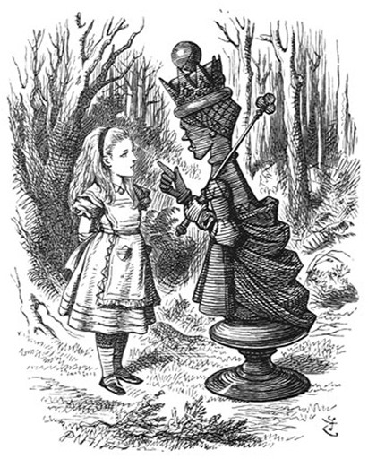
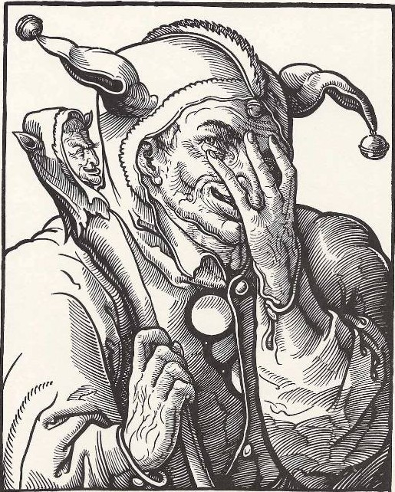
Conclusions
CONCLUSIONS
Thank you
for listening !

Slide 28
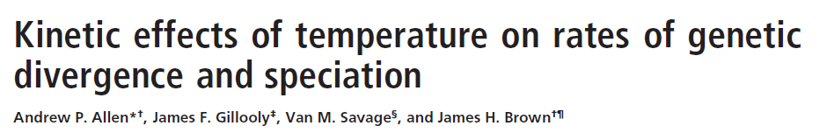
SUPPLEMENTS
Hypothesis for a causation ?
Metabolic theory
T°
T°
T°
Speed of catalyse
Molecular divergence rate
Speciation rate
Brown et al. 2004 – Ecology
Allen et al. 2006 – PNAS

Slide 29
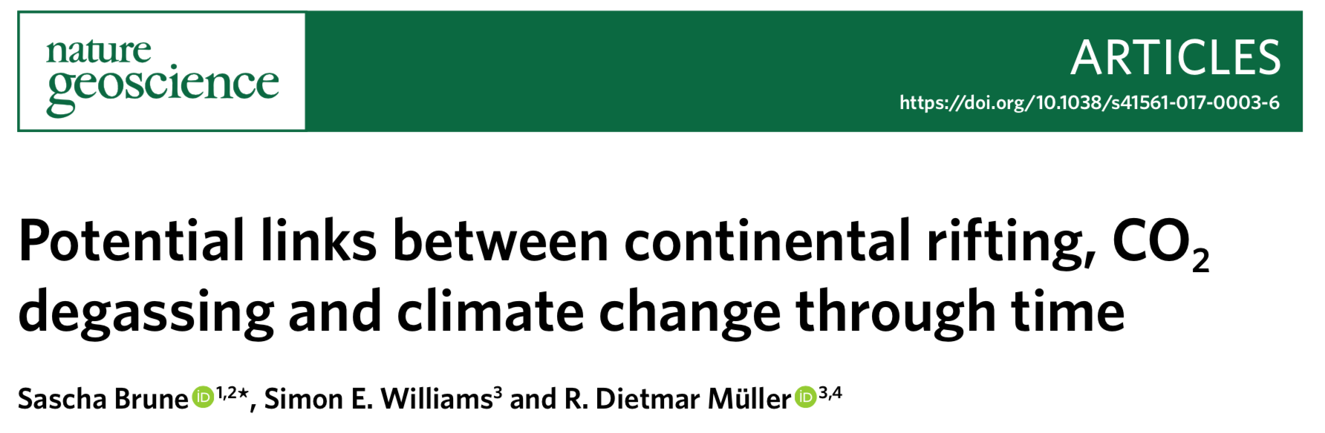
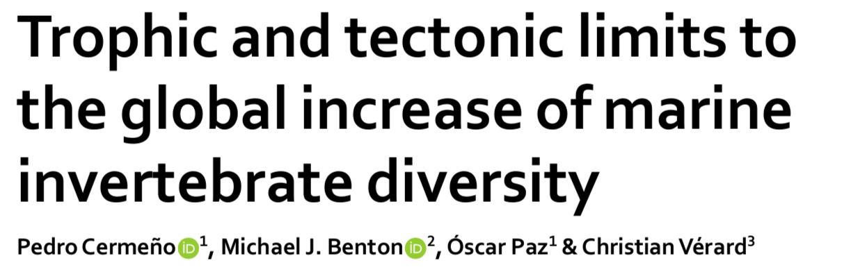
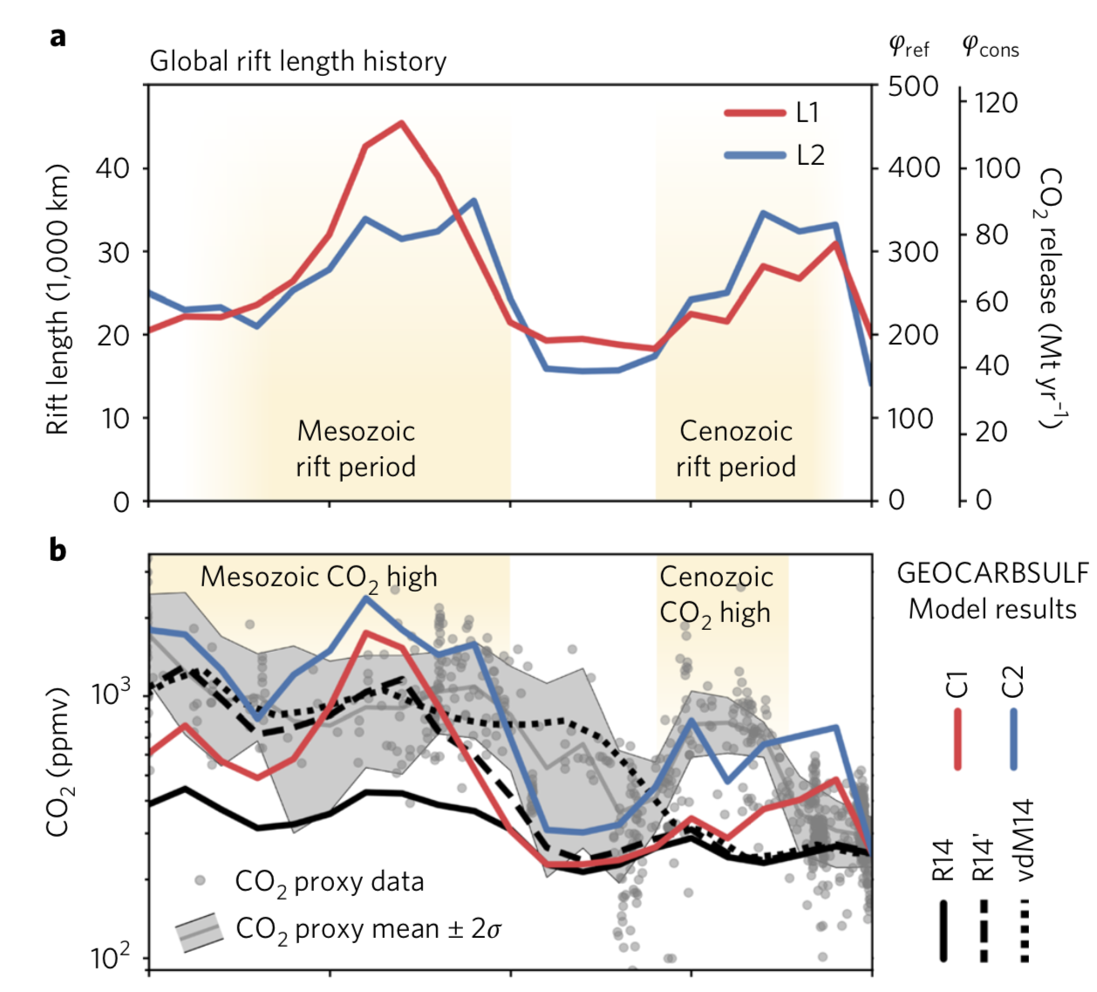
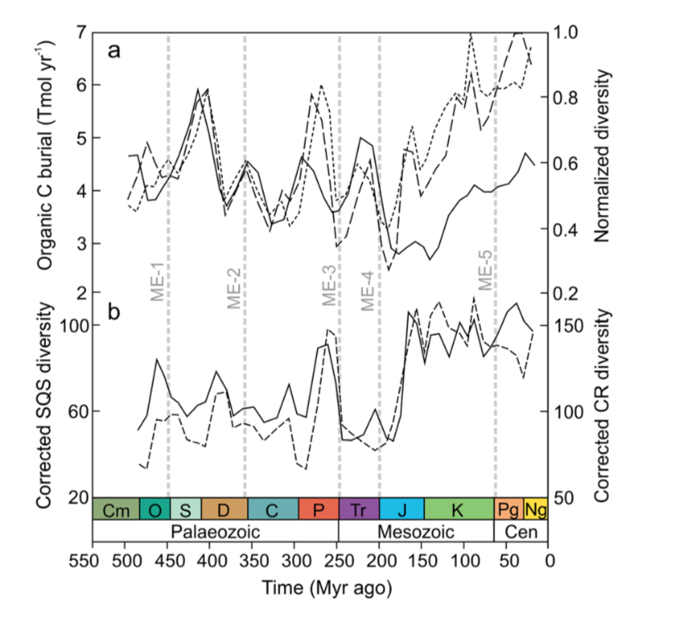
SUPPLEMENTS
Hypothesis for a correlation ?
Resources
Tectonics
CO²

Slide 30
SUPPLEMENTS
Hypothesis for a correlation ?
Resources
Tectonics
CO²

Slide 31
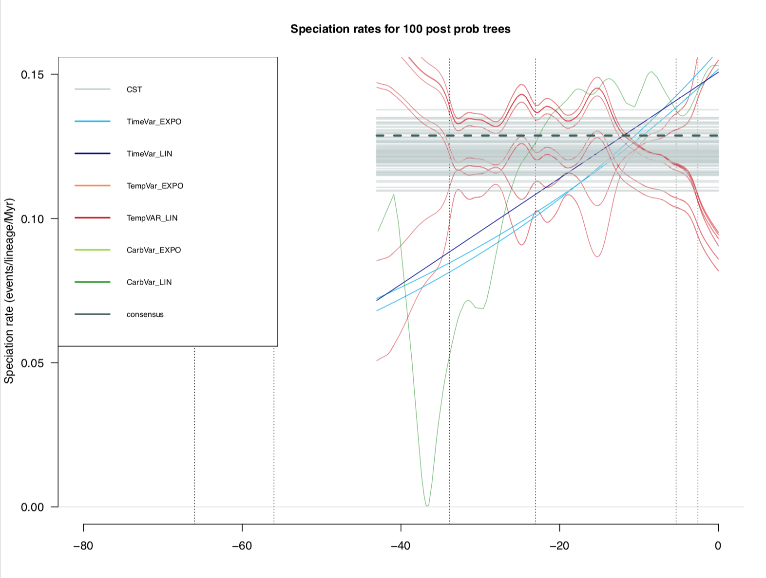
supplements
Strigidae
λ(t)
Best models selected for
100 post probability trees
from Jetz et al. 2012
Consensus tree
t

Slide 32
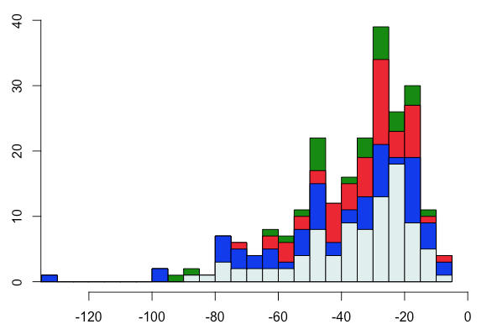
supplements
Selected models and age of phylogenies
CO₂-dependent model
Temperature-dependent model
Number of families
Time-dependent model
Constant model
Crown Age (Mya)

Slide 33
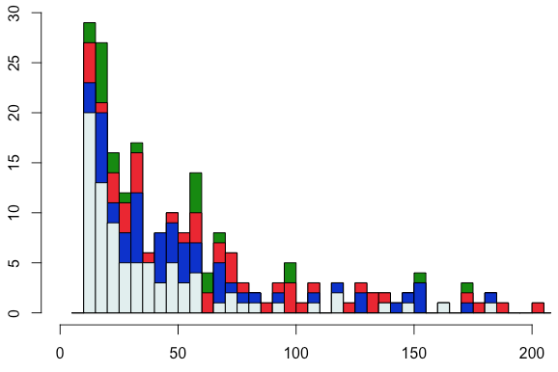
supplements
Selected models and size of phylogenies
CO₂-dependent model
Temperature-dependent model
Number of families
Time-dependent model
Constant model
Number of taxa

Slide 34
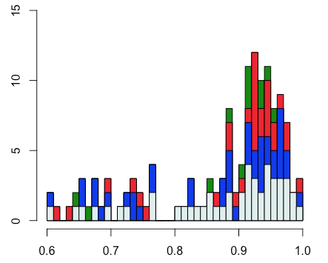
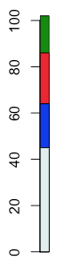
supplements
Selected models and completeness of phylogenies
100 %
Complete phylogenies
< 100 %
Incomplete phylogenies
CO₂-dependent model
Number of families
Temperature-dependent model
Time-dependent model
Constant model

Slide 35
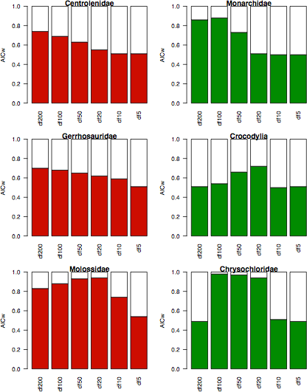
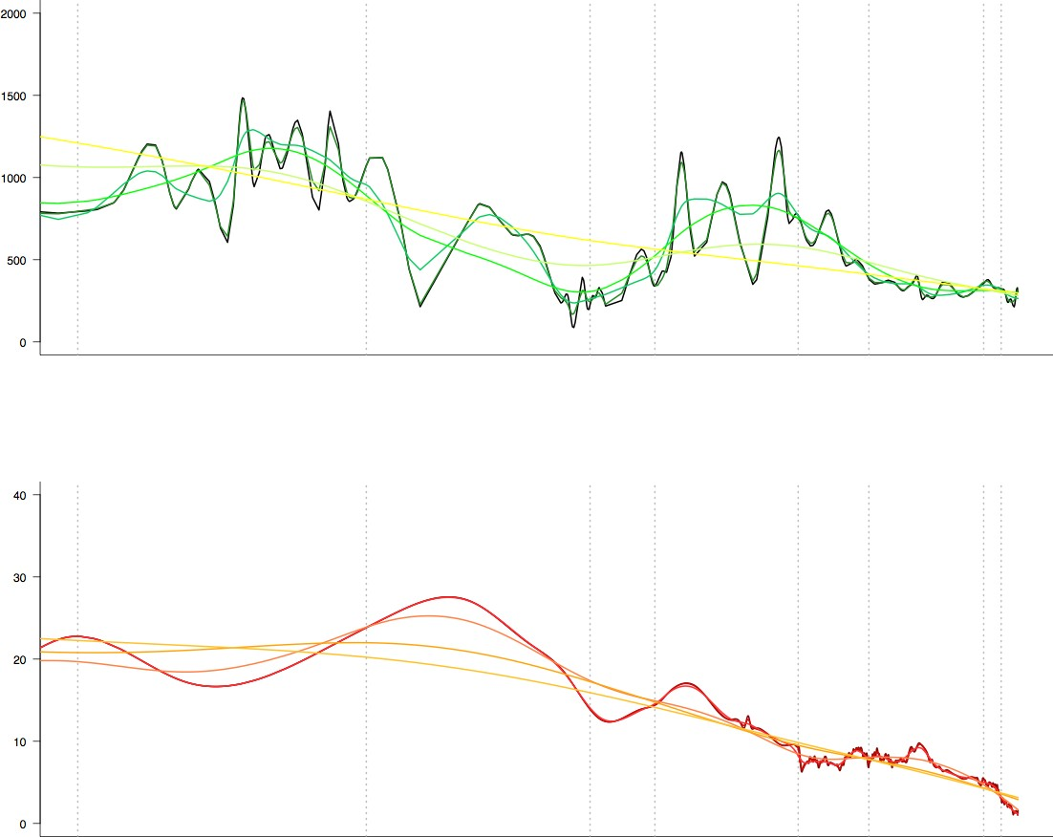
SUPPLEMENTS
High resolution
Poor resolution
CO₂
AICw
Time
T°
Time
T°
CO₂

Slide 36
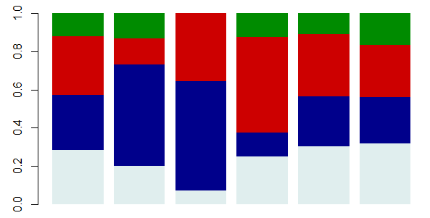
Supplements
Speciation only
Spéciation
CO₂-dépendante
Spéciation Température-dépendante
Spéciation
Temps-dépendante
Spéciation constante
Speciation + Extinction

Slide 37
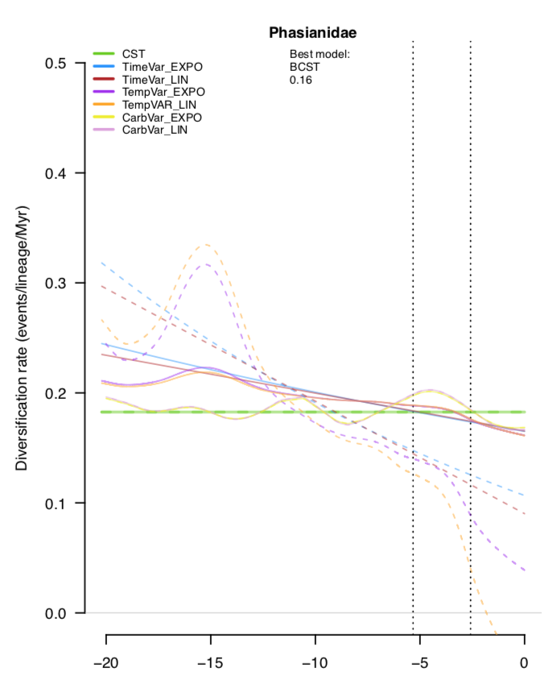
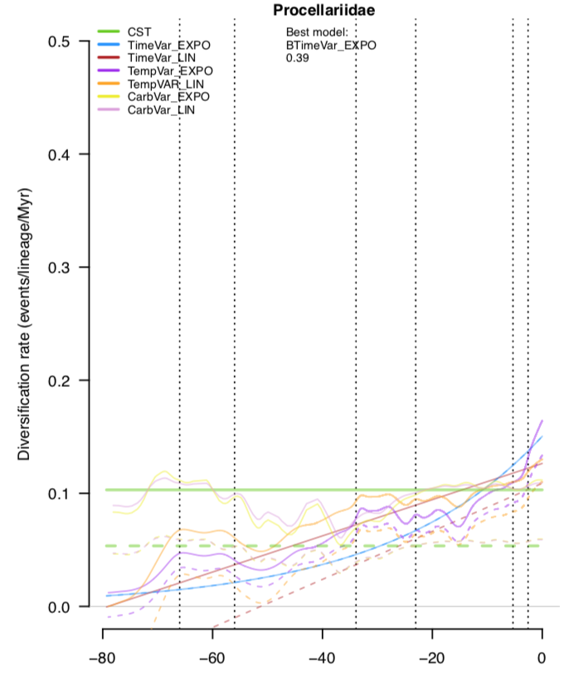
supplements
Negative diversification (extinction > speciation)
Clade loses diversity at present
Clade should go extinct

Slide 38
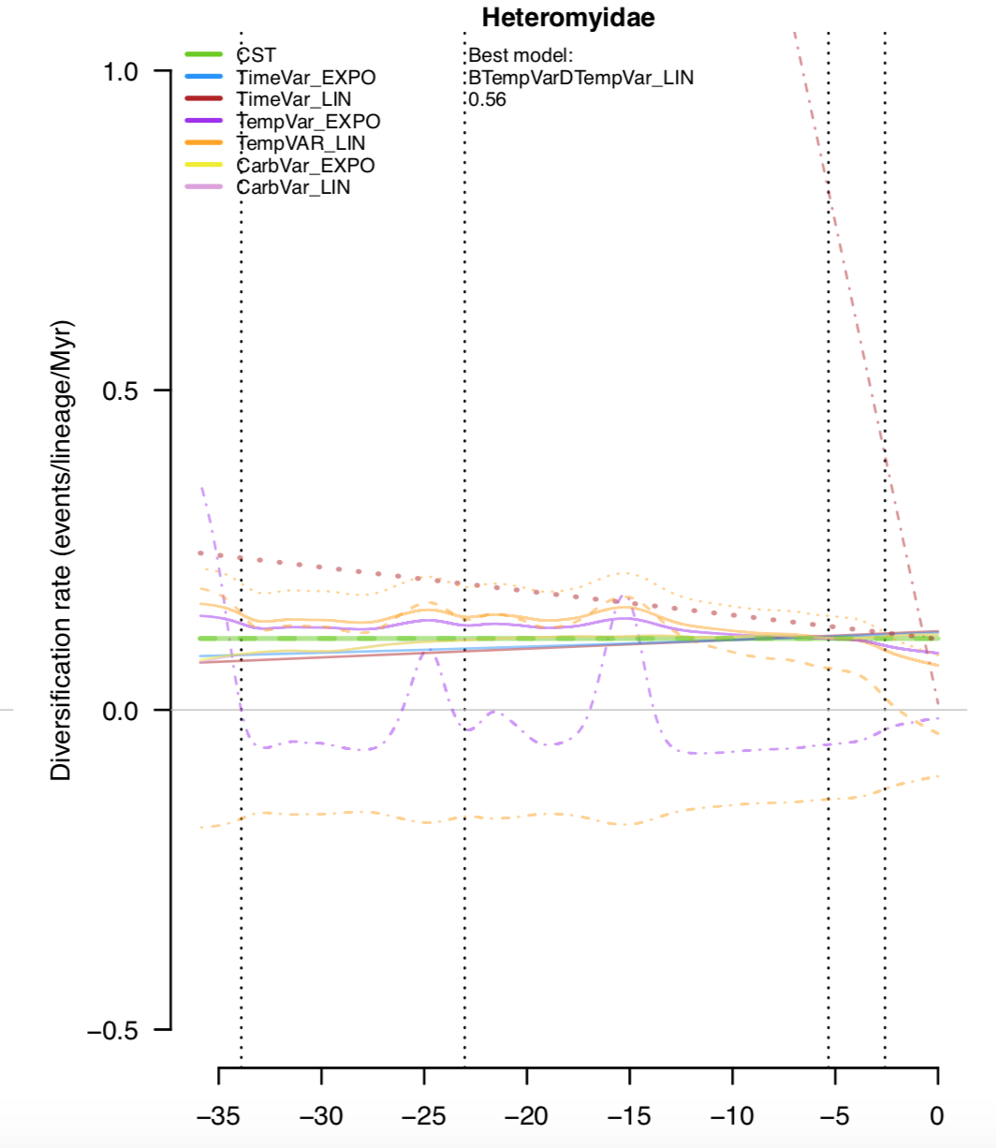
supplements
Support for a model with negative diversification over all the history of the clade !

Slide 39
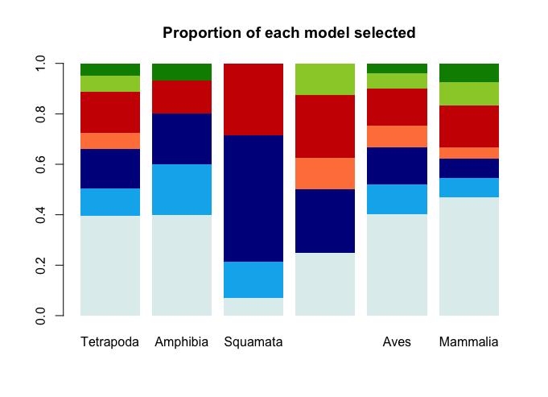
supplements
Deep shade → exponential model
Light shade → linear model

Slide 40
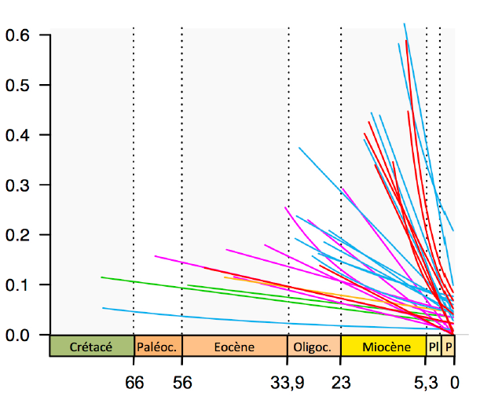

supplements
Positive correlation α > 0
Negative correlation α < 0
49 %
51 %
Speciation (λ)
Spéciation (λ)
Time (Mya)
Time (Mya)
34
9
6
10
2

